Slide 1
Little Big Me Day 2019
Keith Witzenfeld
Notes:
As I’m talking put your hand up to ask questions and I’m happy to answer them if they are relevant

Slide 2
A little bit about me
Keith Witzenfeld
Studied:
Ilford Jewish Primary School
Beis Shammai, Hasmonean, King Solomon
UCL - Pharmacology
Notes:
Hi
Ellie’s dad
HERE
Never heard of it, but you will of others
A-Levels at KS where I did…
Pharmacology is how to make drugs and how they work

Slide 3
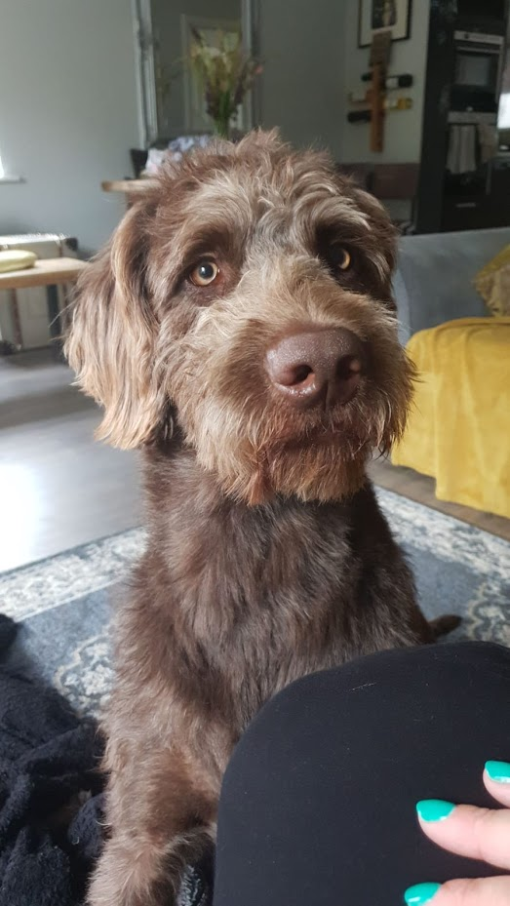
Alvin the Wonder Pup
Notes:
HE’S SO CUTE!
Nothing to do with today at all, but he is mega cute

Slide 4
Banks
Word Search
BARCLAYS
HSBC
LLOYDS
NATWEST
RBS
SANTANDER
CITIBANK
CREDIT SUISSE
GOLDMAN SACHS
JP MORGAN
RBC
SCOTIABANK
TD SECURITIES
UBS
Notes:
First one’s you’ll get
Did you find any of the others, do you know the difference?

Slide 5

One of the world’s top banks, it is split in to different divisions and I work for the Investment Bank
60,000 employees in nearly every country in the world
5,000 in London
25,000 working in Technology
But wait…
What is an investment bank?
Notes:
Have you ever heard of UBS
Every country in the world – where do you think?
US names states, Israel etc…
Technology is where I work

Slide 6
Banking Industry
Retail Banks
Wealth Management
Investment Banks
Hedge Funds
FinTechs
Notes:
Retail = first ones in the answers
UBS is a wealth management bank and one of the biggest in the world
IB explain next
Hedge funds = clients
FinTechs – using technology to make money – new early days

Slide 7
Investment Banks
Banks for Banks or other organisations
Trade in different financial products
Stocks and shares
Bonds
Foreign eXchange
Commodities
Wait a minute… Didn’t you say Pharmacology?!
Notes:
Financial Products
Stock markets: Does anyone know anything about them?
Bonds – how governments and big companies borrow money
FX
I did say pharmacology, but I got to the end of my degree and realised that I didn’t want a career in it

Slide 8
What does a degree really mean?
Russell Group
Commitment
Do what you like or good at!
So wait, do you like what you do?
Umm actually, what DO you do?
Notes:
As someone that hires people (a lot, approximately 60 people over the last three years)
Advice
YES I love it
I don’t really know!

Slide 9
Rates and Credit Market Technology
Director
Manage people
16 people directly
Approximately 80 overall
Financially responsible for the whole of the team
Approximately 180 people in 7 countries
Manage a budget of
My boss is in America
Hey, where’s the technology though?
,000,000
$28
Notes:
Rank
What I do
28 dollars?

Slide 10
Rates and Credit Market Technology
Software for Front Office Traders in Bonds
Before 2000 this was all very manual, people on the phone, running, writing etc…
Connections, pricing and other complex mathematic operations
Oh look a maths test ☺
Notes:
About 100 users globally, countries
Be really excited about the maths
NO IDEA on the calcs ☺

Slide 11
TECHNOLOGY
How many calculations do you think we can do per second?
iPhone X
14,340,000,000
Samsung S9
18,000,000,000
1
,000,000,000,000,000

Slide 12
Technology
Technologies we use:
Excel and the rest of office
Windows
Java
Python
.Net
WFP
Unix
ION
Gradle
Team City
GIT
TCL

Slide 13
Why do I like what I do?
Every day it changes
People
Our building is amazing
I get to do things like this all the time
Travel
Helping people in the bank and outside of it
https://www.youtube.com/watch?v=QZuOUKTlqig

Slide 14
Questions
?

